Slide 1
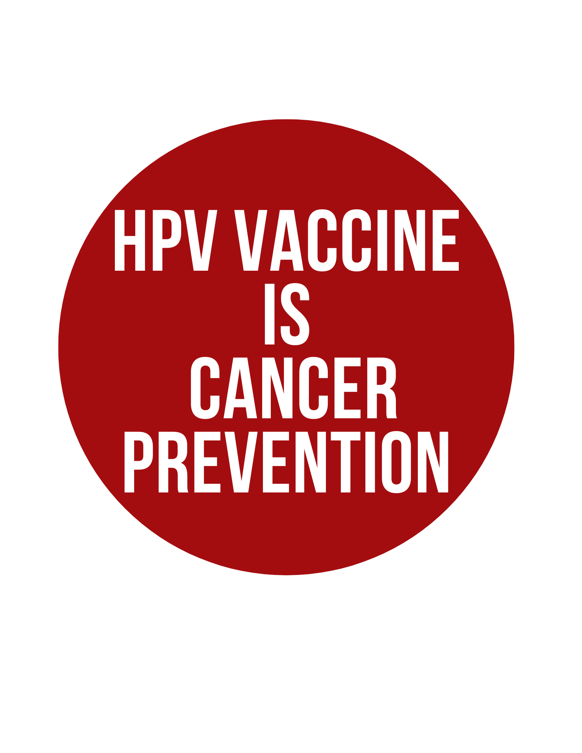
HPV Vaccine is Cancer Prevention
Presented by : Immunize Arkansas and
Arkansas Department of Health
Through a grant from: Arkansas Cancer Coalition
Notes:
Slide 1 – HPV Vaccine is Cancer Prevention
You should have this slide displayed as people arrive and get settled.
Begin the workshop on time and end it on time. The workshop is designed to take no more than one hour. By being punctual, you show your respect for your audience and their time.
Once everyone has been seated and appears comfortable, go to the front of the room and begin with introductions.

Slide 2
Introductions
Insert your picture here.
Notes:
Slide 2 – Introductions (Booklet Cover)
Introduce yourself. Give your name, your title and the organization that you represent. Give any additional information about your organization that you wish to share. Then, offer an introductory exercise. If you have a larger group, you may want to simply have people go around and introduce themselves. Ask them to tell you whether they or a family member have completed the HPV vaccine series before so that you can customize your presentation to a group. You might take different approaches with a group that is already familiar with HPV vaccines than one that is anxious about getting the vaccine. If you have a smaller group, you can do an exercise like the following:
A Sample Introductory Exercise:
Have people partner with someone that they do not know.
Ask people to interview their partner and find out:
Their name
Occupation
Whether or not they, or a family member, has had cervical cancer or other HPV cancer
Have each person, in turn, introduce their partner to the group.

Slide 3
Overview
What is HPV?
How is HPV spread?
HPV and how to stay healthy.
Let’s talk about the HPV Vaccine.
Let’s Talk: Questions and Concerns
Notes:
Slide 3 – Overview (Booklet Cover)
Say: “Today, we will be talking about:
What HPV is
How HPV is spread
HPV and how to stay healthy
The HPV vaccine
And we will share personal stories, if you are comfortable, and address any concerns you may have.
But, before we begin, we would like to find out more about what you already know about HPV and the HPV vaccine, so we will ask you to do this warm up activity.”
Hand out the warm-up activity sheet. Read each question aloud, in case someone has difficulty reading the questions. Give enough time for them to fill it out – they will turn them in at the end of the program. People do not need to put their names on them.
Next, you will refer to the booklets. If the booklets were not handed out at the registration table, you will want to distribute them now. Make sure everyone has a copy.

Slide 4
What is HPV?
HPV is a very common virus
There are over 150 types of HPV
Both men and women can be infected
Notes:
Slide 4 – What is HPV? (Booklet Page 1)
Say: “Let’s talk about HPV. Please turn to page 1 in your booklets. Looking at page 1, can anyone tell me what causes HPV?” (If no one raises his or her hand, refer to the first sentence.) Your response might be: “Yes, very good. A germ called a virus causes HPV. The virus can infect both men and women and does not pick its victim based on gender. ”
Say: “There are many types of HPV--over 150 types. Some types are known to cause other serious health problems.”

Slide 5
What is HPV?
In most cases your body will kill the virus
If HPV stays in your body it can cause major health issues
HPV can cause other health problems, including:
Cancer
Genital Warts
Normal cell
HPV damages cell
Cancer or genital warts
Notes:
Slide 5 – HPV and Health (Booklet Page 1)
Say: “Most of the time when the HPV virus gets into your body, your body naturally kills it and there are no health problems that follow. However, if it does stay in your body, the virus damages your cells. If your cells are damaged from the virus, you can get cancer or genital warts.”

Slide 6
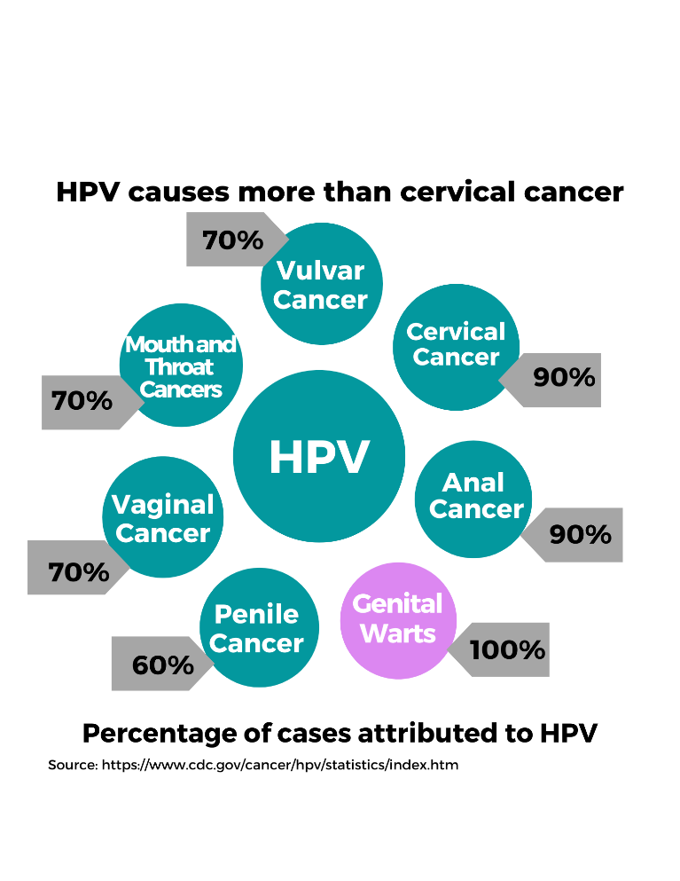
HPV and Cancer
There is no way to know who will get an HPV related cancer
Throat cancer is most common in men
Cervical cancer is most common in women
Notes:
Slide 6 – HPV and Cancer (Booklet Page 1)
Say: “The biggest and most serious issue associated with HPV is cancer.”
Say: “As you can see, HPV can cause a lot of different types of cancer. HPV can cause specific cancers in women only, such as vaginal, vulvar, and cervical cancer. Cervical cancer is the most common HPV cancer in women. Arkansas has one of the highest rates of cervical cancer in the United States based on the number of cervical cancer cases we have in our state. There is only one type of cancer that men get that women cannot, that is penile cancer. However, the most common HPV cancer for men is throat cancer. Arkansas also has one of the highest rates of throat cancer in the U.S.”

Slide 7
HPV and Genital Warts
Both men and women can get genital warts
What are genital warts?
Small bumps in the genital area
Appearance:
Small or large
Tall or flat
Shaped like cauliflower
If you think you have them, tell your doctor!
Notes:
Slide 7 – HPV and Health: Genital Warts (Booklet Page 2)
Say: “HPV can also cause genital warts. As you can see from your booklet, the way the warts look can change. In some people, they appear as small or large, tall or flat, or cauliflower shaped bumps in the genital area.”
Say: “The good news is that genital warts can be treated by your doctor. If you suspect that you have genital warts, talk to your doctor or health care provider and discuss treatment options.”

Slide 8
How is HPV spread?
Intimate skin-to-skin contact
Intercourse is the main way HPV is spread
Where do I not get the virus from?
Notes:
Slide 8 – How is HPV Spread? (Booklet Page 3)
Ask: “Can anyone tell me if HPV can still be spread even if the person who has it does not have any signs of having the virus?” If no one answers, consider prompting them to read page 3 in the booklet or begin sharing the sentence below. If someone answers, “yes,” consider responding with “correct, we will delve a little farther into that on this slide.”
Say: “HPV is spread through skin-to-skin contact, specifically intimate contact such as sexual intercourse. The virus itself goes from person to person through tiny breaks in the top layer of your skin.”
Say: “One of the unfortunate things about HPV is that it can be spread and the person who has it first may never know. HPV is a strong virus and because it is strong it spreads very easily. Almost everyone at some point in their life will be infected by at least one type of the HPV virus.”
Say: “You do not get HPV from toilet seats, hugging or holding hands, swimming in pools or tubs, sharing food or eating utensils or poor hygiene”.

Slide 9
How is HPV spread?
People can spread HPV even if they do not have symptoms
Most people with HPV never develop symptoms
People who get infected often find out too late that they have HPV
Notes:
Slide 9 - How is HPV Spread? (Booklet Page 3)
Say: “Because people who have HPV may never have symptoms, people who they pass the HPV virus may never know. But for the people that do get sick from the virus, it is often really late in the infection and sometimes people find out too late that they are sick from the virus.”

Slide 10
How is HPV spread?
What does too late mean?
When you get diagnosed with cancer.
Notes:
Slide 10 - How is HPV Spread? (Booklet Page 3)
Say: “For some people, too late is when they are diagnosed with a type of cancer. There is no way to know which people that get infected with HPV will get cancer, either.”

Slide 11
What can I do to protect myself?
Practice safe sex:
Use condoms:
They do not completely protect you
They do minimize your risk for getting HPV
Ask your doctor about regular screenings:
It is easier for women to get screened than men
Get vaccinated!
Notes:
Slide 11 – What can I do to protect myself? (Booklet Page 4)
Say: “Although HPV is a strong virus, there are a few ways to protect yourself from getting the most dangerous kinds.”
Say: “First, you can use condoms. They do not 100% protect you from the virus, but they do reduce the chance of you getting the virus or a second type of the HPV virus if you have already been infected by one of them.”
Say: “Second, you can talk to your doctor about regular screenings, specifically women! There is a type of test called a pap smear or pap test that your doctor can do to test if you have damaged cells in your cervix that could lead to cancer.”
Say: “Third, you can get vaccinated, if you are below a certain age, to prevent infection with 9 of the most common and dangerous types of HPV viruses. We will discuss the ages for vaccination in just a few minutes.”

Slide 12
What can I do to protect my children?
Notes:
Slide 12 – What can I do to protect my children? (Booklet Page 5)
Say: “The best way to prevent your children from getting HPV related cancers in the future is to have them vaccinated before they are ever exposed to the virus. The vaccine is recommended so early in a child’s life because doctor’s want to be proactive and prevent their exposure long before they are sexually active. Plus pre-teens develop a stronger response to the vaccine than older teens.”
Say: “Although it may seem strange to you to vaccinate your children so young, doctors are not suggesting that your child may be having sex at the age of 9, they are trying to protect your child long before HPV infection becomes a problem! Ultimately, the HPV vaccine is the key to preventing your child from getting an HPV-related cancer when they are much older!”

Slide 13
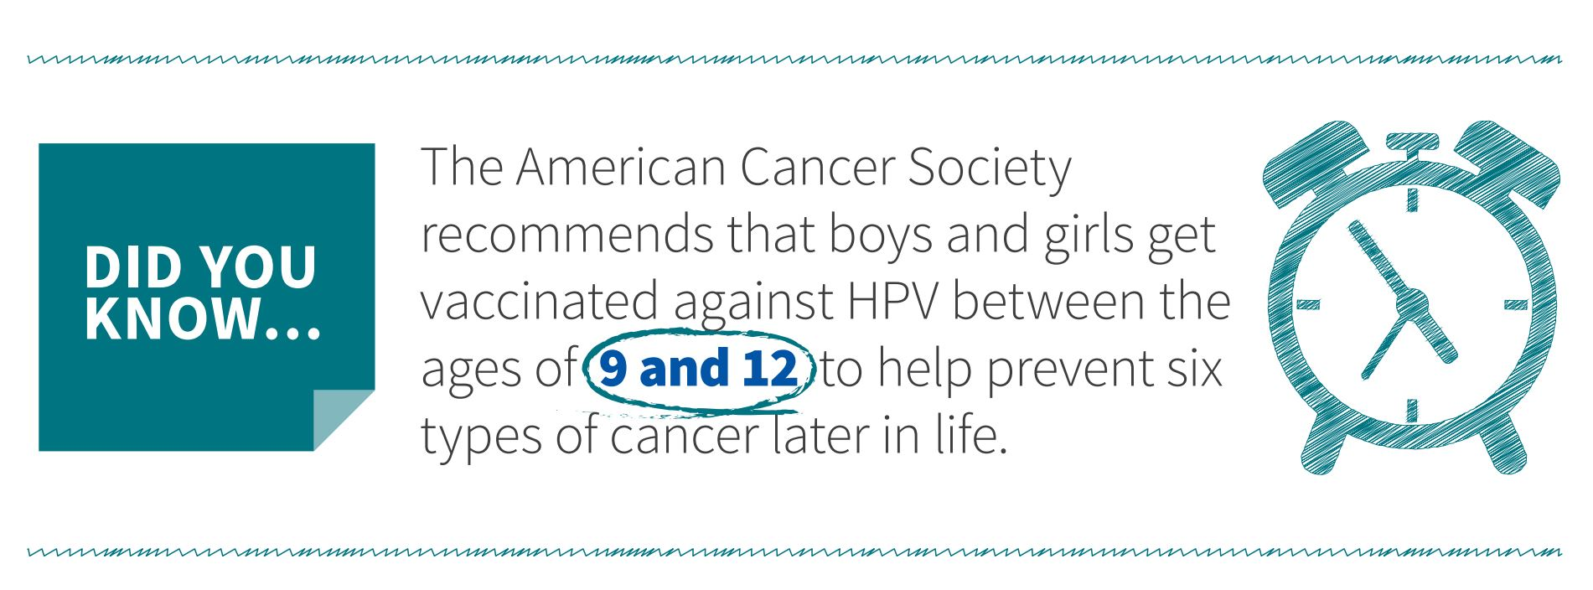
HPV Vaccine is Cancer Prevention
Who should get the HPV vaccine?
The HPV vaccine works best when given between ages 9 and 12 for boys and girls.
Men and women through age 26.
Adults ages 27 through 45 who had not been adequately vaccinated make shared decisions with their health care provider about getting vaccinated.
Notes:
Slide 13 – Let’s talk about the HPV vaccine! (Booklet Page 5)
Say: “Let’s talk about who should get the vaccine. The vaccine works best when boys and girls are 9-12 years old because their immune system, which is the part of the body that fights off the infection, will have a stronger response when they are younger. If you or your children did not get vaccinated between 9 and 12 years old, that is not a problem! It is still important to get vaccinated. Men and women through the age of 26 years old can get vaccinated as well. Also, in 2019 the recommendations changed and adults aged 27 – 45 who have not previously been adequately vaccinated can talk to their health care provider about getting the vaccine. Depending on a person’s age, they may get a different number of doses. We will talk about that next.”

Slide 14
HPV Vaccine is Cancer Prevention
How many doses of the vaccine will I need?
If you get your first dose before your 15th birthday, you will need 2 doses.
Second dose: 6 to 12 months after your first dose
If you get your first dose after your 15th birthday, you will need 3 doses.
Second dose: 1 to 2 months after your first dose
Third dose: 6 months after your first dose
Notes:
Slide 14 – Let’s talk about HPV! (Booklet Page 6)
Say: “So, let’s talk about how many doses of the vaccine are needed. The number of doses that you need depends on your age. If the person getting their first dose of the HPV vaccine is less than 15 years old, they will need 2 doses--with the second dose given 6 to 12 months after the first dose. If the person receiving their first dose of the HPV vaccine has already had their 15th birthday, then they will need to get 3 doses of the vaccine. They will get the second dose 1 to 2 months after the first, and the third dose 6 months after the first dose.”
Say: “There are also times when boys and girls under the age of 15 years old need to get 3 doses of the vaccine. Your doctor will tell you if that is the case for you. Also, each one of the doses will be given as a shot in your upper arm.”

Slide 15
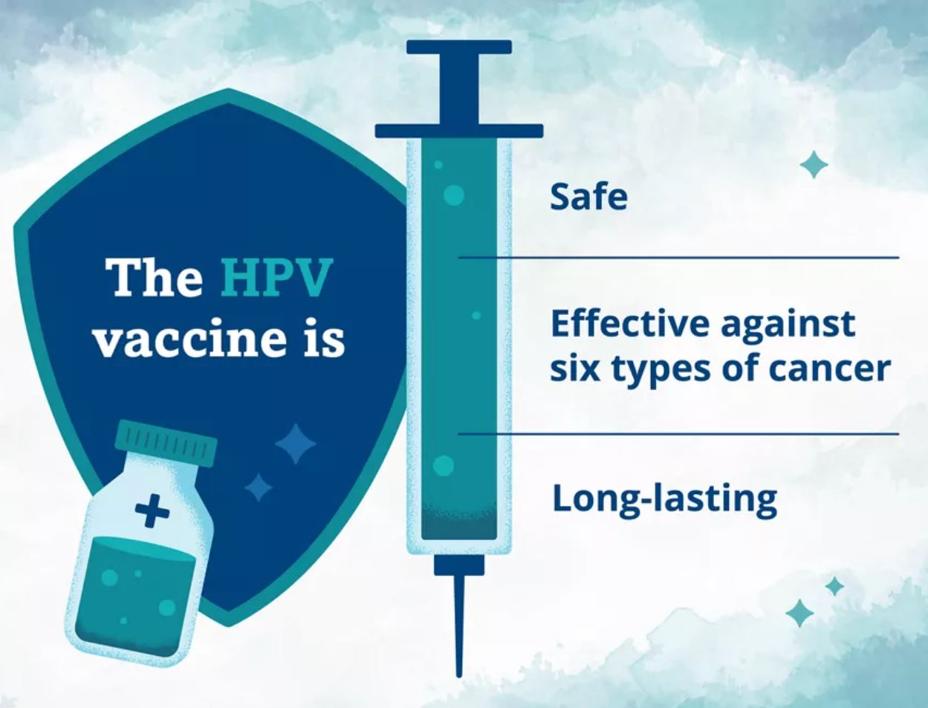
HPV Vaccine is Cancer Prevention
Who should not get the HPV vaccine?
Anyone who has had a severe allergic reaction to a previous dose of the vaccine.
Anyone who has a life-threatening allergy to the vaccine to any ingredient in the vaccine.
Notes:
Slide 15 – Let’s talk about the HPV Vaccine! (Booklet Page 7)
Say: “There are certain times when someone should not get the vaccine. People who have had a severe allergic reaction to a previous dose of the HPV vaccine or a life-threatening allergy to any ingredient in the vaccine should not get the vaccine. You can always ask your doctor or pharmacist about ingredients in the vaccine if you are concerned about a possible allergic reaction.”
Say: “The vaccine is safe if you have not had an allergic reaction to the vaccine or an ingredient in the vaccine. The Centers for Disease Control and Prevention, which is also called the CDC, and the United States Food and Drug Administration carefully looked at the vaccine before it was allowed to be used.”

Slide 16
HPV Vaccine is Cancer Prevention
Does the vaccine have side effects?
The HPV vaccine might have some side effects. Side effects that do occur are a result of your immune system working!
Fever
Headache
Arm pain
Feeling Tired
Fainting
Notes:
Slide 16 – Let’s talk about the HPV vaccine! (Booklet Page 8)
Say: “Many people are concerned about side effects that vaccines can cause. The most common and normal side effects of the HPV vaccine are pain, redness, or swelling in the part of the arm where the dose was given, fever, a headache, or feeling tired.”
Say: “Fainting is also a common side effect in teenagers and some adults after getting a shot—not just the HPV vaccine. In other words, the fainting occurs as a result of getting the shot, and it’s not due to anything in the vaccine. For that reason, your doctor, nurse, or pharmacist may have you sit down for 15 minutes after getting a dose of the vaccine.”

Slide 17
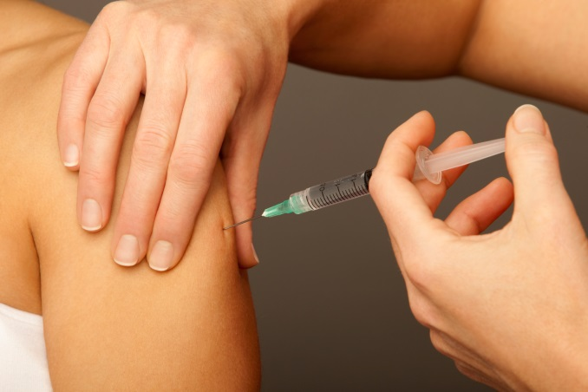
HPV Vaccine is Cancer Prevention
The Vaccine is:
Very safe and effective
Best way to prevent cancer!
Notes:
Slide 17 – Let’s talk about the HPV vaccine (Booklet Page 7)
Say: “The vaccine is safe, effective, and the best way to prevent you or a loved one from getting an HPV cancer. You can get the HPV vaccine at certain doctor’s offices, pharmacies, and the Arkansas Department of Health’s local health units throughout the state. Be sure to call ahead to make sure they have the vaccine on hand and verify what type of payment may be needed, if any.

Slide 18
Why is this important in Arkansas?
Arkansas ranks:
49th for females 13-17 who have received the HPV vaccine series correctly
47th for males 13-17 who have received the HPV vaccine series correctly
50th for cases of cervical cancer
Notes:
Slide 18 – Why is this important in Arkansas? (Booklet Page X)
Say: “You may wonder why this is especially important in Arkansas. Currently, we have the most cases of cervical cancer based on the number of people that live in our state compared to other states. We are also ranked very poorly in how many of our boys and girls between 13 and 17 years old who have received the correct number of HPV vaccine doses. This is extremely important for our state to improve, because we could be preventing thousands of future cases of cancer in our state.”

Slide 19
Let’s Talk
What does your doctor say about the HPV vaccine?
What do your family and friends say about the HPV vaccine?
What do you say about the HPV vaccine?
Notes:
Slide 19 – Let’s Talk (Booklet Page 10)
Ask: “Have you discussed the HPV vaccine with your doctor? What do your family and friends say about the HPV vaccine? What do you say about the HPV vaccine?”
Begin discussion about the HPV vaccine here. See the addendum for additional information about possible issues that might be brought up and additional resources of answers.
Ask participants to turn to the story page of the booklet and to read the stories. Once you can tell that they have finished, ask: “Is anyone willing to share a story about the HPV vaccine or an HPV-related health problem?” If you have one that you are willing to share, this would be a good time to do so.

Slide 20
Thank you!
Thanks to the Centers for Disease Control and Prevention for some text and pictures used in the presentation.
Thanks to Immunize Arkansas’s HPV Vaccine Workgroup for helping to adapt the materials and plan the workshops.
Notes:
Slide 20 – Thank you!
Say: “We would like to thank Immunize Arkansas, the Arkansas Cancer Coalition and the Arkansas Department of Health for making this workshop possible.”
Say: “Before you go, we would like to have you fill out this final ‘What Did I Learn?’ sheet. (On the other side of the warm-up activity.) The questions are the same as the warm-up activity, but we’d like you to complete them anyway so we can find out what you learned today.”
Read each question aloud, in case someone has difficulty reading the questions. Give enough time for them to fill it out and return it to you. Collect all of the warm-up activity sheets at this time. People don’t need to put their names on them. As you collect the ‘What Did I Learn?’ sheets, thank each person for coming.

