Slide 1
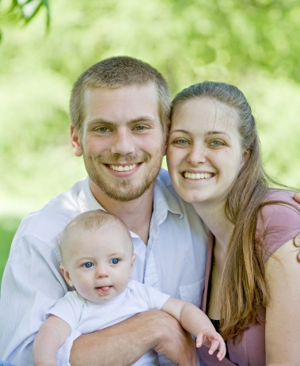
Let’s Talk About The Flu
Presented by : The Arkansas Immunization Action Coalition and
Arkansas Department of Health
Through a grant from: Association of State and Territorial Health Officials
With support from: Emory University
Notes:
You should have this displayed as people arrive and get settled.
Begin the workshop on time and end it on time. The workshop is designed to take no more than one hour. By being punctual, you show your respect for your audience and their time.
Once everyone has been seated and appears comfortable, go to the front of the room and begin with introductions.

Slide 2
Introductions
Notes:
Slide 2- Introductions (Booklet Page 1)
Introduce yourself. Give your name, your title and the organization that you represent. Give any additional information about your organization that you wish to share. Then, offer an introductory exercise. If you have a larger group, you may want to simply have people go around and introduce themselves. Ask them to tell you whether they have ever gotten a flu vaccine before so that you can customize your presentation to a group. You might take different approaches with a group that is already familiar with flu vaccines than one that is anxious about getting a flu vaccine. If you have a smaller group, you can do an exercise like the following:
A Sample Introductory Exercise:
Have people partner with someone that they do not know.
Ask people to interview their partner and find out:
Their name
Occupation
Whether or not they have ever gotten a flu vaccine
Have each person, in turn, introduce their partner to the group.

Slide 3
Overview
What is the flu?
How do you keep your family healthy?
What should you do if you get sick?
Let’s talk about flu vaccines.
Flu Stories
Questions and concerns
Notes:
Slide 3 – Overview
Say: “Today, we will be talking about:
What the flu really is
How to keep your family healthy
What you should do if you get sick
We will talk about flu vaccines
We will talk about flu stories and concerns
But, before we begin, we would like to find out more about what you already know about flu and flu vaccines, so we will ask you to do this warm up activity.”
Hand out the warm-up activity sheet. Consider reading each question aloud, in case someone has difficulty reading the questions. Give enough time for them to fill it out and return it to you.
Next, you will refer to the lesson. If the lesson books were not handed out at the registration table, you will want to distribute them now. Make sure everyone has a copy.

Slide 4
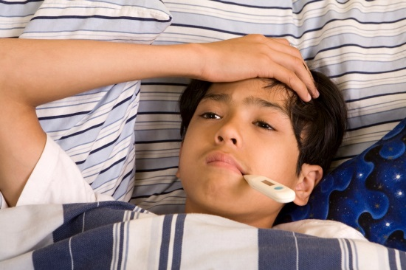
What is the flu?
Caused by a virus
Also called “influenza”
Comes on quickly
Can last from 2 days to 2 weeks (usually around 7 days)
Notes:
Slide 4 – What is the Flu? (Booklet Page 1)
Say: “Let’s talk about the flu. Please turn to page 1 in your lesson books. Looking at the lesson, Can anyone tell me what causes the flu?” (If no one raises their hand, refer to the first sentence.) Your response might be: “Yes, very good. Flu is caused by a germ called a virus. Another type of germ is called a bacteria. Other illnesses caused by a bacteria are treated with an antibiotic. You may have had a sore throat that was caused by a strep bacteria and then you would have been given an antibiotic. But, the flu is caused by a virus, so an antibiotic will not get rid of the flu. However, flu can be treated by an anti-viral medicine that is only for the flu. It doesn’t treat other viruses and works best if given within 48 hours of a person becoming ill. “Flu is really just short for Influenza. The way that you can tell that your sickness is probably flu, is that it comes on very quickly and lasts from 2 days to 2 weeks.”

Slide 5
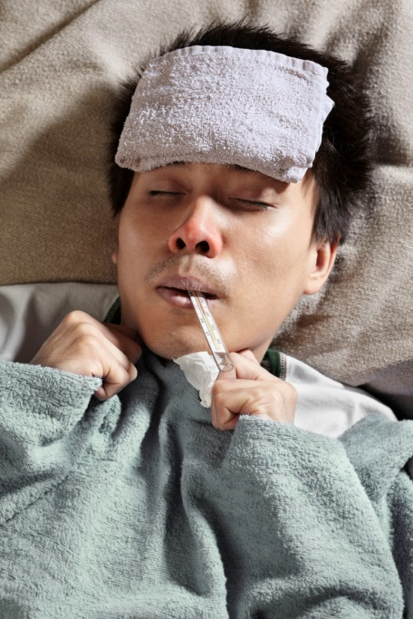
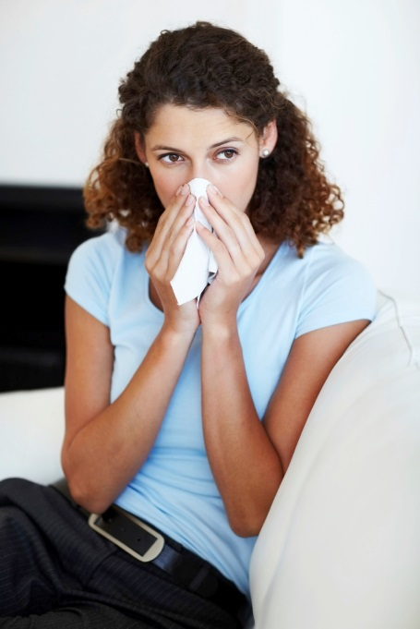
How will I know if I have the flu?
Flu
Cold
You may feel:
Fever
Chills
Body aches
Cough
Sleepy/Fatigue
Notes:
Slide 5 – How Will I Know if I Have the Flu? (Booklet Page 2)
Say: “Can you tell me some of the symptoms or things that you feel when you are sick with from Influenza?” The answers you should get in no particular order are:
Fever
Chills
Body aches
Cough
Fatigue or sleepiness
Headache
Sore throat
Runny nose
Sneezing
“Can anyone tell me what you feel like when you have fever, chills or body aches?” The answers might be:
Fever
Your body feels hot
Temperature on thermometer of over 37.5–38.3 °C (99.5–100.9 °F) rectally (in the bottom, behind or butt)
Temperature on thermometer of over 37.7 °C (99.9 °F) orally (by mouth)
Temperature on thermometer of over 37.2 °C (99.0 °F) under the arm or in the ear.
Your body feels cold (may precede a feeling of warmth)
Sweating
Chills
Feeling cold
Shaking
Body aches
Muscles hurting
Bones hurting
“Can anyone tell me what it feels like or sounds like or maybe looks like to have cough or fatigue?” Answers may be:
Cough
Ask them to demonstrate a cough
Fatigue
Tiredness
Sleepy

Slide 6
How will I know if I have the flu?
Headache
Sore throat
Runny or stuffy nose
Sneezing
Kids may have:
Vomiting
Diarrhea
Belly Ache
Notes:
Slide 6 – How Will I Know if I Have the Flu? (Booklet Page 2)
Say: Can anyone tell me what a headache, sore throat, runny nose or sneeze feel or sound like?” Answers may include:
Headache (Point to head)
Pain in the head
Pain in the neck
Sore throat (Point to throat)
Pain in throat
Funny sounding voice
Runny nose (Point to nose)
Stuffy nose
Snotty nose
Nasal congestion
Sneeze (Have someone demonstrate a sneeze)
Achoo
“Children may also have vomiting, diarrhea and belly ache. What do we mean by vomiting?”
Answers may be:
Throwing up
“What do we mean by diarrhea?”
Runny poop
Loose stool
“Does anyone know another name for belly ache?”
Nausea
“Not all children throw up and not everyone has a fever. But they are pretty common with the flu.”
If you go to a clinic, they can do a test using a swab from the back of your nose to see if you have the flu.

Slide 7
How can my family stay healthy?
Wash your hands often with soap and water.
If soap and water are not available, use an alcohol-based hand rub.
Notes:
Slide 7 – How Can My Family Stay Healthy? (Booklet Page 2)
Say: “The flu can be spread very easily from one person to another. Germs may pass around easily through a sneeze or touching surfaces with germs on them. It is important to prevent this spread in order to keep you and your family healthy. If one person gets sick, it puts all others around at risk of getting the flu including family and loved ones. Thankfully, there are simple ways to prevent us all from getting sick and experiencing those horrible symptoms that we just learned about. You should wash your hands with soap and water, but if soap and water are not available, you can use an alcohol-based hand rub.”

Slide 8
How to wash effectively
When washing hands with soap and water:
Wet your hands with clean running water and apply soap. Use warm water if possible.
Rub both hands together to make a lather.
Continue rubbing hands for 15-20 seconds. Need a timer? Imagine singing "Happy Birthday" twice through to a friend.
Rinse hands well under running water.
Notes:
Slide 8 – How To Wash Effectively (Booklet Page 2)
Say: “I am sure you all know how to wash your hands, but let’s take a closer look at how to wash your hands to get rid of germs.
Try to use warm water to wet your hands under running water.
Rub your hands together so that the soap gets lathery or bubbly.
Does anyone know how long to wash your hands? You want to rub your hands together with the soap and water for at least 30 seconds, or as long as it takes to sing the “Happy Birthday” song twice. Would anyone be willing to show us how you wash your hands and sing Happy Birthday?”
If you have a specific ethnic group and know of a song that would be more culturally appropriate, use that. Or, you could ask the group to come up with another song that they would prefer to use.
“After singing and rubbing, you will want to rinse your hands thoroughly.”

Slide 9
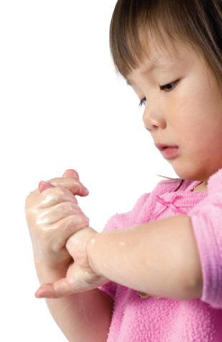
And…
Dry your hands using a paper towel or air dryer. If possible, use your paper towel to turn off the faucet.
Always use soap and water if your hands are visibly dirty.
Notes:
Slide 9 – And… (Booklet Page 2)
Say: “Once your hands are clean, use a paper towel or air dryer to dry them. Use the paper towel to also shut off the water if you can. Does anyone know why that is a good idea?”
Answers may include:
There may be germs on the handle that someone else put there.
You touched the handle with your germy hands before washing them and now will get those germs back on your hands.
“If your hands are really dirty and you can see how dirty they are, you should wash with soap and water.”

Slide 10
How to use hand sanitizers
Using an alcohol-based hand sanitizer:
If soap and clean water are not available, use an alcohol-based hand rub to clean your hands.
Alcohol-based hand rubs reduce the number of germs on skin and are fast-acting.
Apply product to the palm of one hand.
Rub hands together.
Rub the product over all surfaces of hands and fingers until hands are dry.
Notes:
Slide 10 – How To Use Hand Sanitizers (Booklet Page 2)
Say: “If you cannot use soap and water to wash your hands, you can use a hand sanitizer. They work quickly and also get rid of germs on your hands. To use the hand sanitizer:
Put it in the palm of your hand (show the palm of your hand).
Rub your hands together
Rub it all over your hands including your fingers
Rub it all over until your hands are dry.”

Slide 11
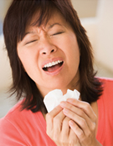
What else can we do?
Always cover your mouth and nose with a tissue when coughing or sneezing.
Avoid touching your eyes, nose and mouth.
Wash your hands after using a tissue.
Notes:
Slide 11 – What Else Can We Do? (Booklet Page 2)
Say: “So we know how to get rid of the germs once they get on our hands, but what should we do to avoid spreading the germs if you cough or sneeze? What should you do?”
Answers should include:
Cover your cough or sneeze with a tissue
Cough or sneeze into your elbow
“If you cough or sneeze into a tissue, it is very important to throw away the tissue immediately. DO NOT cough or sneeze into your hand since then you will need to wash your hands again to avoid spreading the germs.”

Slide 12
Or…
Cough or sneeze into your elbow.
Notes:
Slide 12 – Or… (Booklet Page 2)
Say: “Can anyone show me how you sneeze into your elbow? What part of your elbow should you use?”
You may need to make it clear that it is the inside of the elbow that we are talking about.

Slide 13
And…
The flu is spread when you come into close contact with other people who are sick with the flu.
Avoid close contact (being within about 6 feet) with persons with flu symptoms.
Get a flu vaccine.
Notes:
Slide 13 – And…(Booklet Page 2)
Say: “If you know that someone has the flu, stay away from them. Try to stay at least 6 feet from someone who is sick. If someone has flu symptoms, don’t take a chance on catching it too. Just stay away from them.”
People with the flu can spread it to other 24 hours or more before they actually have symptoms, so that makes it hard to avoid everyone with the flu.

Slide 14
What should I do if I get sick?
If you get sick with flu-like symptoms, you should stay home and avoid contact with other people except to get medical care.
Notes:
Slide 14 – What Should I Do if I Get Sick? (Booklet Page 3)
Say: “It is important for you to stay home and rest if you get the flu.”
Ask: “What might be a good reason for going out of the house even though you have the flu?”
After listening to responses, you might say: “One of the only reasons to go out would be for a medical appointment. The doctor can do a flu test and prescribe an anti-viral medicine for you to take.”

Slide 15
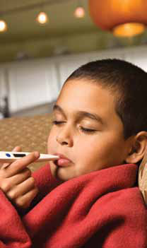
Don’t spread the flu – stay home
Stay home until you have no fever for 1 day.
After you have no fever for 1 day, you can return to work or school.
Notes:
Slide 15 – Don’t Spread the Flu - Stay Home (Booklet Page 3)
Say: “Stay home until your fever is gone for one day: It is important to limit contact with others while having the flu to protect them from getting sick. This means staying at home from whatever your commitments are (work, school, etc). And, while at home, it is important to stay away from others in the household or they will be at very high risk of getting the flu. Take your temperature during this time with a thermometer. Normal temperature for most adults and children with a thermometer in your mouth, under the tongue, is 98.6 F or 37.0 C. Once your temperature is back to normal, wait 1 more day until leaving the house. Until then, you still place others at risk to get the flu.”
Remind them to call their medical provider rather than just showing up at a hospital or clinic. (Fever should be gone on its own and without the use of medication.)

Slide 16
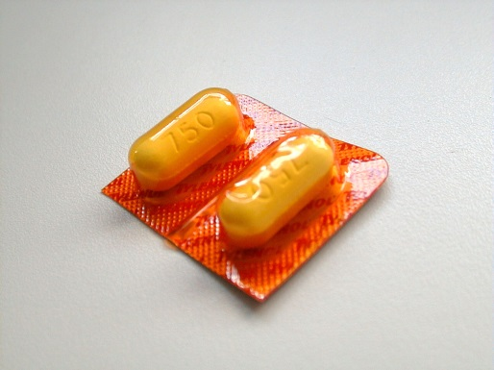
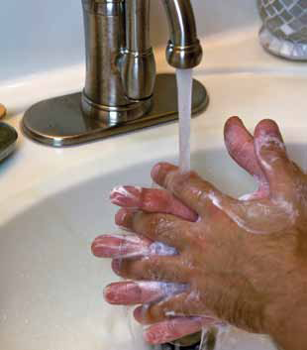
And…
Rest as much as you can.
Take acetaminophen (Tylenol).
Wash your hands with soap and warm water after you sneeze, cough, or blow your nose.
Notes:
Slide 16 – And… (Booklet Page 3)
Say: “It is important that you rest as much as you can while you are at home. It will also make you feel better if you take acetaminophen. Another name for acetaminophen is Tylenol. There are other medicines you can take to lessen flu symptoms, such as ibuprophen, which is also called Advil. However, you should talk to a pharmacist before taking any over-the-counter medicine, because there may be a reason you should not take acetaminophen or ibuprophen depending on other health problems you may have. Please be sure to never give aspirin to a child with flu-like symptoms.”

Slide 17
Use the items in your flu kit
Thermometer: take your temperature with a thermometer:
Hold it in your mouth for 1 minute.
If it reads more than 99 degrees, you have a fever.
Hand sanitizers: Practice good hand washing and sanitizing.
Notes:
Slide 17 – Use the Items in Your Flu Kit (Booklet Page 3)
You may hand out the flu kits at this time, if they are being provided and if you did not have them on the registration table. Make sure everyone gets one. Take the items out of the flu kit as you talk about them.
Ask: “Would someone be willing to take out the thermometer from their kit and show us how you would use it in your mouth?”
The packages are hard to open and you will need a scissors. Another option is just for you to have one open and demonstrate in front of the class.
Make sure that they put the thermometer under their tongue and press the button on the front of the thermometer after it is in the mouth. Wait until it beeps and then read the temperature. Explain the process that you are using and explain what the normal ranges are for an oral temp. The thermometers we have make a special beep when temp is over 99 degrees, so it is an extra indication that you have a fever. More info is in the instructions.
Show how the hand sanitizers work using the guidelines from slide #10.

Slide 18
And…
Tissues: Use tissues when you sneeze or cough.
Keep used tissues in a closed waste basket and throw them away yourself when you feel better.
Cough drops
Don’t go to work or out of the house until you do not have a fever for 1day.
Notes:
Slide 18 – And… (Booklet Page 3)
Say: “Be sure to throw away used tissues since they can also spread the flu to others if they pick them up. Germs can be spread in several ways. The cough drops will help if you have a cough, and remember that it is important to stay home when you are sick.”

Slide 19
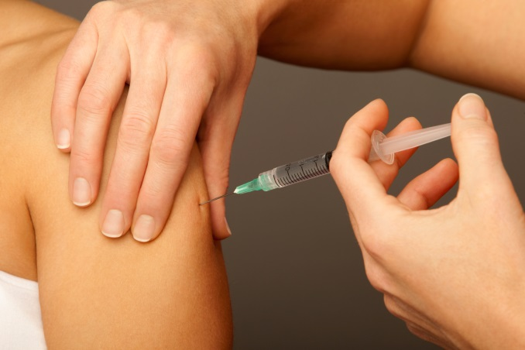
Let’s Talk About Flu Vaccines
Flu vaccines are also called flu shots.
Some flu vaccine comes as a nose spray.
Have your family vaccinated, too.
Very safe and effective
Best way to prevent the flu!
Notes:
Slide 19 – Let’s Talk About Flu Vaccines (Booklet Page 4)
Say: “Flu vaccination is recommended for everyone 6 months of age and older. We often also call the flu vaccine a flu shot, although the flu vaccine can be given in other ways besides just a shot. Some flu vaccine comes as a nose spray, which is also called a flu mist. Flu mist is approved for people ages 2-49 years of age. It can be administered or given in the nose as well. You and your Dr. or nurse will need to decide which way it is best to get your flu vaccine.”
Ask: “Why would it be important for your family to get a flu vaccine if you are getting a flu vaccine?”
Emphasize in your discussion that your family is out in public with other people who might expose them to the flu.
Say: “Flu vaccines are the number one way to prevent the flu. They are safe and effective. Hand washing and coughing or sneezing into the elbow are good health practices at preventing sickness in general, including the flu. However, none work nearly as well at preventing the flu as the flu vaccine.”
Emphasize that the flu vaccine is the number one way to prevent the flu because it is one of the questions on the test.

Slide 20
Who Should Get a Flu Vaccine?
Most People
Everyone 6 months and older
Pregnant Women
Older Adults
Health care workers
People with asthma
People with diabetes
People with heart disease
Smokers
Notes:
Slide 20 – Who Should Get a Flu Vaccine? (Booklet Page 3)
Say: “Anyone can get the flu every year, so most of us should get the vaccine. There are certain people that especially should get the vaccine because of an increased risk for having severe illness that can lead to a stay in the hospital or death. There is also a small group that shouldn’t get the vaccine.”
The flu vaccine can give a person a sore arm and a low fever after injection. These symptoms are varied and are significantly milder and shorter lived than the actual flu. This type of reaction shows that the flu shot is doing what it is supposed to do-training the body to fight the flu. It does not mean that someone should not get the vaccine.
However, if you have had a severe reaction to the flu vaccine in the past, you should not get one. Fortunately, such life-threatening allergic reactions are very rare. Signs of serious allergic reaction can include:
breathing problems
hoarseness or wheezing
hives
paleness
weakness
a fast heartbeat
dizziness
If they do occur, it is within a few minutes to a few hours after the vaccine. These reactions are more likely to occur among persons with a severe allergy to an ingredient in the vaccine.

Slide 21
Who Should NOT Get a Flu Vaccine?
Anyone who is allergic to a component in the flu vaccine
Anyone who has had a severe reaction to a flu vaccine in the past
Talk to your doctor, nurse or pharmacist
if you have questions.
Notes:
Slide 21 – Who Should Not Get a Flu Vaccine? (Booklet Page 3)
Say: “The people who should not get a flu vaccine are those who have a severe allergy to any of the ingredients in the vaccine or anyone who has ever had a severe reaction to a flu vaccine in the past.
People with egg allergies can safely take the vaccine. However, if a person is concerned about having a very severe reaction, they can get the vaccine in a doctor’s office (such as an allergist or primary care doctor) where they can be monitored afterward.”
Note: Because reactions are rare, do not emphasize these items. This information is supplied to you so that if you are asked what an allergic reaction might look like, you can share this information. However, again, try to stress that these reactions are very rare.
Some people are adamant that they got the flu from the vaccine in the past and it is best not to argue with them. Allow them to have their opinion, but emphasize that it would be highly unusual since the flu vaccine does not have a live virus in it.
It is important to note that the flu vaccine absolutely cannot cause an illness. A person can get the vaccine and still get the flu. This does not mean that the vaccine gave them the flu.
The body takes 2 weeks to build up its defenses after receiving the vaccine. The person could get the flu during those 2 weeks, but will also build immunity for the rest of the flu season.
Even after 2 weeks, the vaccine is not totally effective in preventing the flu, but it can still help keep a person out of the hospital or may even save their life, if they actually do get the flu.

Slide 22
Did You Know?
The flu vaccine teaches your body how to fight the flu.
You should get a flu vaccine every year.
The flu vaccine only protects you from the flu, not colds or other illnesses.
Notes:
Slide 22 - Did You Know? (Booklet Page 5)
Say: “Flu vaccines teach your body to fight the flu. They teach your immune system, the part of your body that fights sickness, to recognize and kill the flu. So, hopefully, if a person who has received the flu vaccine comes into contact with the flu virus, their body will know exactly what it is and kill the flu germs before they become sick. Sometimes the vaccine is not enough to keep a person from getting the flu, but in that case the vaccine can help the body fight the flu enough to keep someone out of the hospital or keep them from dying. It is important to get a new flu vaccine every year, because each year the flu changes. We get a flu vaccine every year, so we can teach our body to fight off the new version of the flu. Flu vaccines are typically available in September or early October, right at the beginning of flu season. Get the vaccine early, but also know that it is never too late. The flu vaccine absolutely will not cause an illness. ”

Slide 23
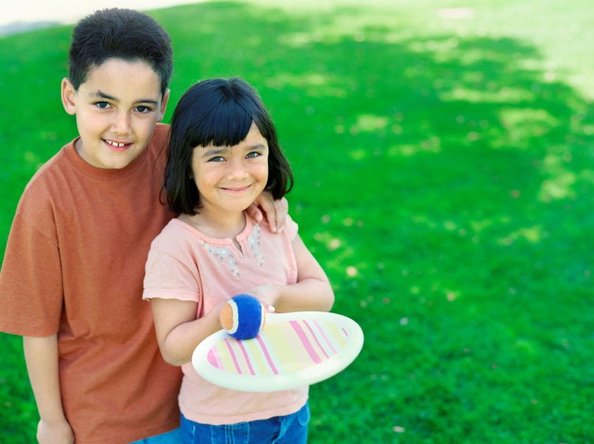
Let’s Review
Quiz on page 5 of your booklet
Circle True or False
Notes:
Slide 23 – Let’s Review (Booklet Page 5)
Say: “Please turn to page 5 in your lesson book. See the questions under True or False? Circle the correct answer as I read the question:
A flu vaccine will protect you from a cold. Circle T if you think this is true or F if you think this is false.
A flu vaccine will protect you from the flu. Mark T or F.
Vomiting is always caused by the flu.
The flu causes fever, chills, cough and body aches. You will feel very sick for 7 days.
Newborn babies should get a flu vaccine.
Let’s correct this little quiz.” (You might ask the group what the correct answer is and why before giving the correct answer.)
“1. Is False. If you remember, we discussed how the flu vaccine only protects you from the flu and not from other illnesses. So, if you marked F, you are correct.
2. Is True.
3. Is False. Children often have vomiting with the flu, but not always and adults sometimes have vomiting, but not commonly.
4. Is True.
5. Is False. Newborn babies are too young to take the flu vaccine. They depend on everyone around them to get the vaccine to protect them from the flu.”

Slide 24
Where can I get a flu vaccine?
Talk to your local doctor, a nurse, pharmacist or public health clinic to find out more information about where you can get a flu shot.
The flu vaccine is quick and easy to get and will help keep you and your family healthy this flu season.
Notes:
Slide 24 – Where Can I Get a Flu Vaccine? (Booklet Page 5)
If no arrangements have been made to give flu vaccines to participants at the end of the workshop, It would be helpful for you to research the times and locations of area flu clinics, especially the Arkansas Department of Health’s mass flu clinic in your county. Share whatever information you have about locations near you or direct people to contact their local clinic or public health about where to get flu vaccines. If flu vaccine will not be provided to the participants at the end of the workshop, and if you have obtained vouchers for free flu vaccines for your participants in advance, you will also want to hand out the vouchers if you have not already done so.

Slide 25
Everyone Has a Story
See booklet pages 6 and 7.
Do you have a story to share about an experience you have had with getting the flu or a flu shot?
Notes:
Slide 25 – Everyone Has a Story (Booklet Pages 6&7)
Ask participants to turn to pages 6 and 7 and to read the stories. Once you can tell that they have finished, ask: “Is anyone willing to share a story about the flu or flu vaccine?” If you have one that you are willing to share, this would be a good time to do so.

Slide 26
Let’s Talk
What does your doctor say about flu vaccines?
What do your family and friends say about flu shots?
What do you say about flu vaccines?
Notes:
Slide 26 – Let’s Talk (Booklet Page 8)
Ask: “Have you discussed the flu vaccine with your doctor? What do your family and friends say about flu vaccines? What do you say about flu vaccines?” Begin discussion about flu vaccines here. See the addendum for additional information about possible issues that might be brought up and additional sources of answers.

Slide 27
Thank you!
Thanks to the Centers for Disease Control and Prevention for some text and pictures used in the presentation.
Thanks to Wisconsin Health Literacy for creating the materials that the Arkansas Department of Health adapted for us to use in Arkansas.
Thanks to Arkansas Immunization Action Coalition’s Flu Prevention Workgroup for helping to adapt the materials and plan the workshops.
Notes:
Slide 27 – Thank you!
Say: “We would like to thank the Arkansas Immunization Action Coalition and the Arkansas Department of Health for making this workshop possible.
Before you go, we would like to have you fill out this final question and answer form. (Pass it out now.) The questions are the same as the warm-up activity, but we’d like you to complete them anyway so we can find out what you learned today. Please answer the ‘What Did You Learn?’ questions and thank you for coming.”
If applicable, say: “If you would like to get your flu vaccine before you leave, we have staff from ____ clinic or pharmacy set up in the back of the room to give it to you.”

