Slide 1
Workshop in Wã in COVID-19:
Katak kin Melele ko Remool Ñan Am Kōjpārok Eok im Bōbrae Ro Jet

Slide 2
Karuwānene!
Karreo | Rule ko | Ta ünin ad bed ijin

Slide 3
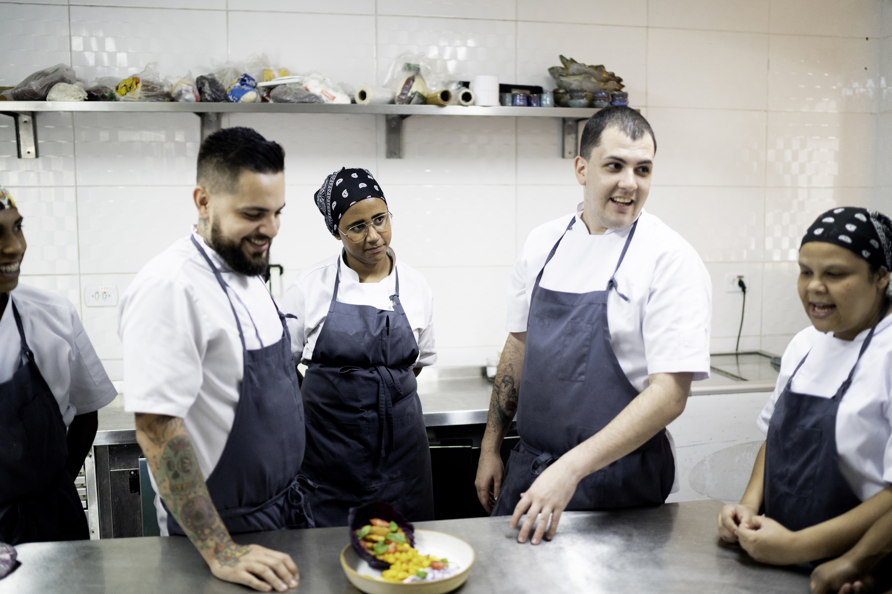
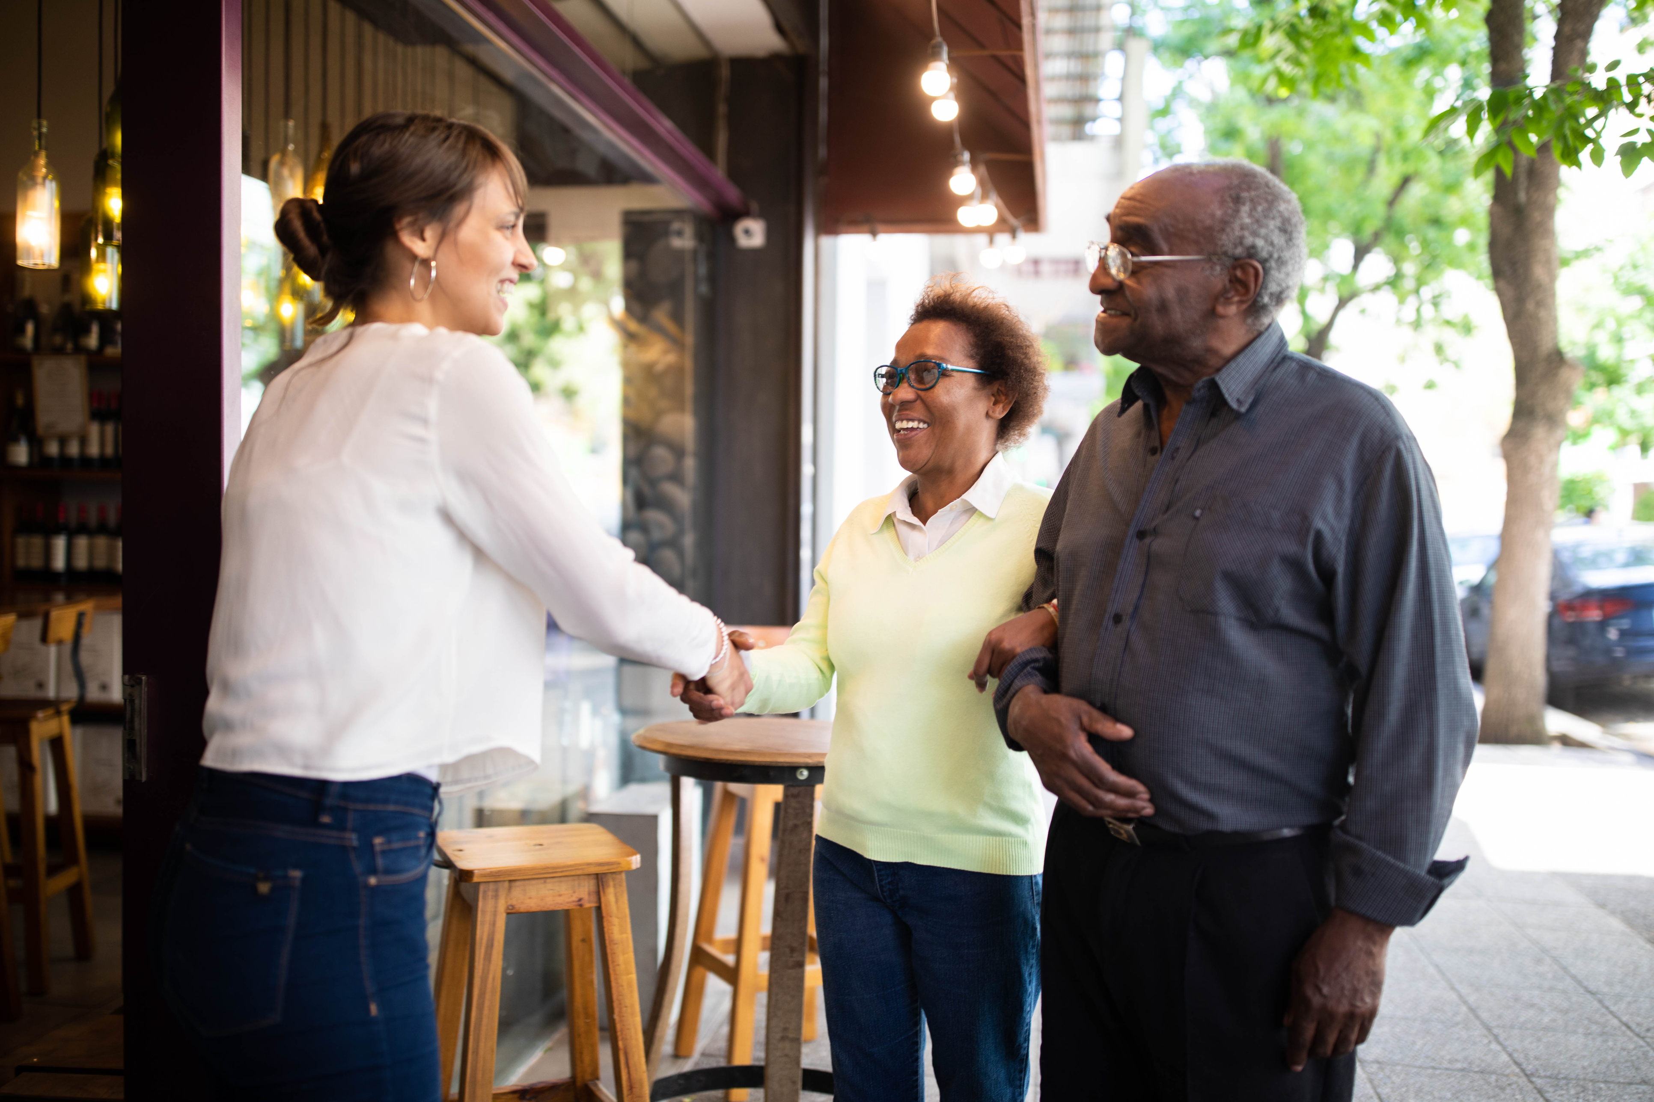
Aolep rej bed ilo kaüwõtata ilo aer bōk COVID-19
Wōn ian ro mōttam im ro nükum emōj an jelōte er?

Slide 4
Ewōr jet ro im elaplok an kauwōtata ñan aer bōke COVID-19
Ro rej jerbal ilo jikin ko ebwijn armej ilo ie:
Armej ro emarok kilier
Mōn mōñā ko | Jikin jerbal ko | Jikin jiküül ko | Jikin taktō ko
Rikilmeej | Ri-Hispanic | Ri-Majōl

Slide 5
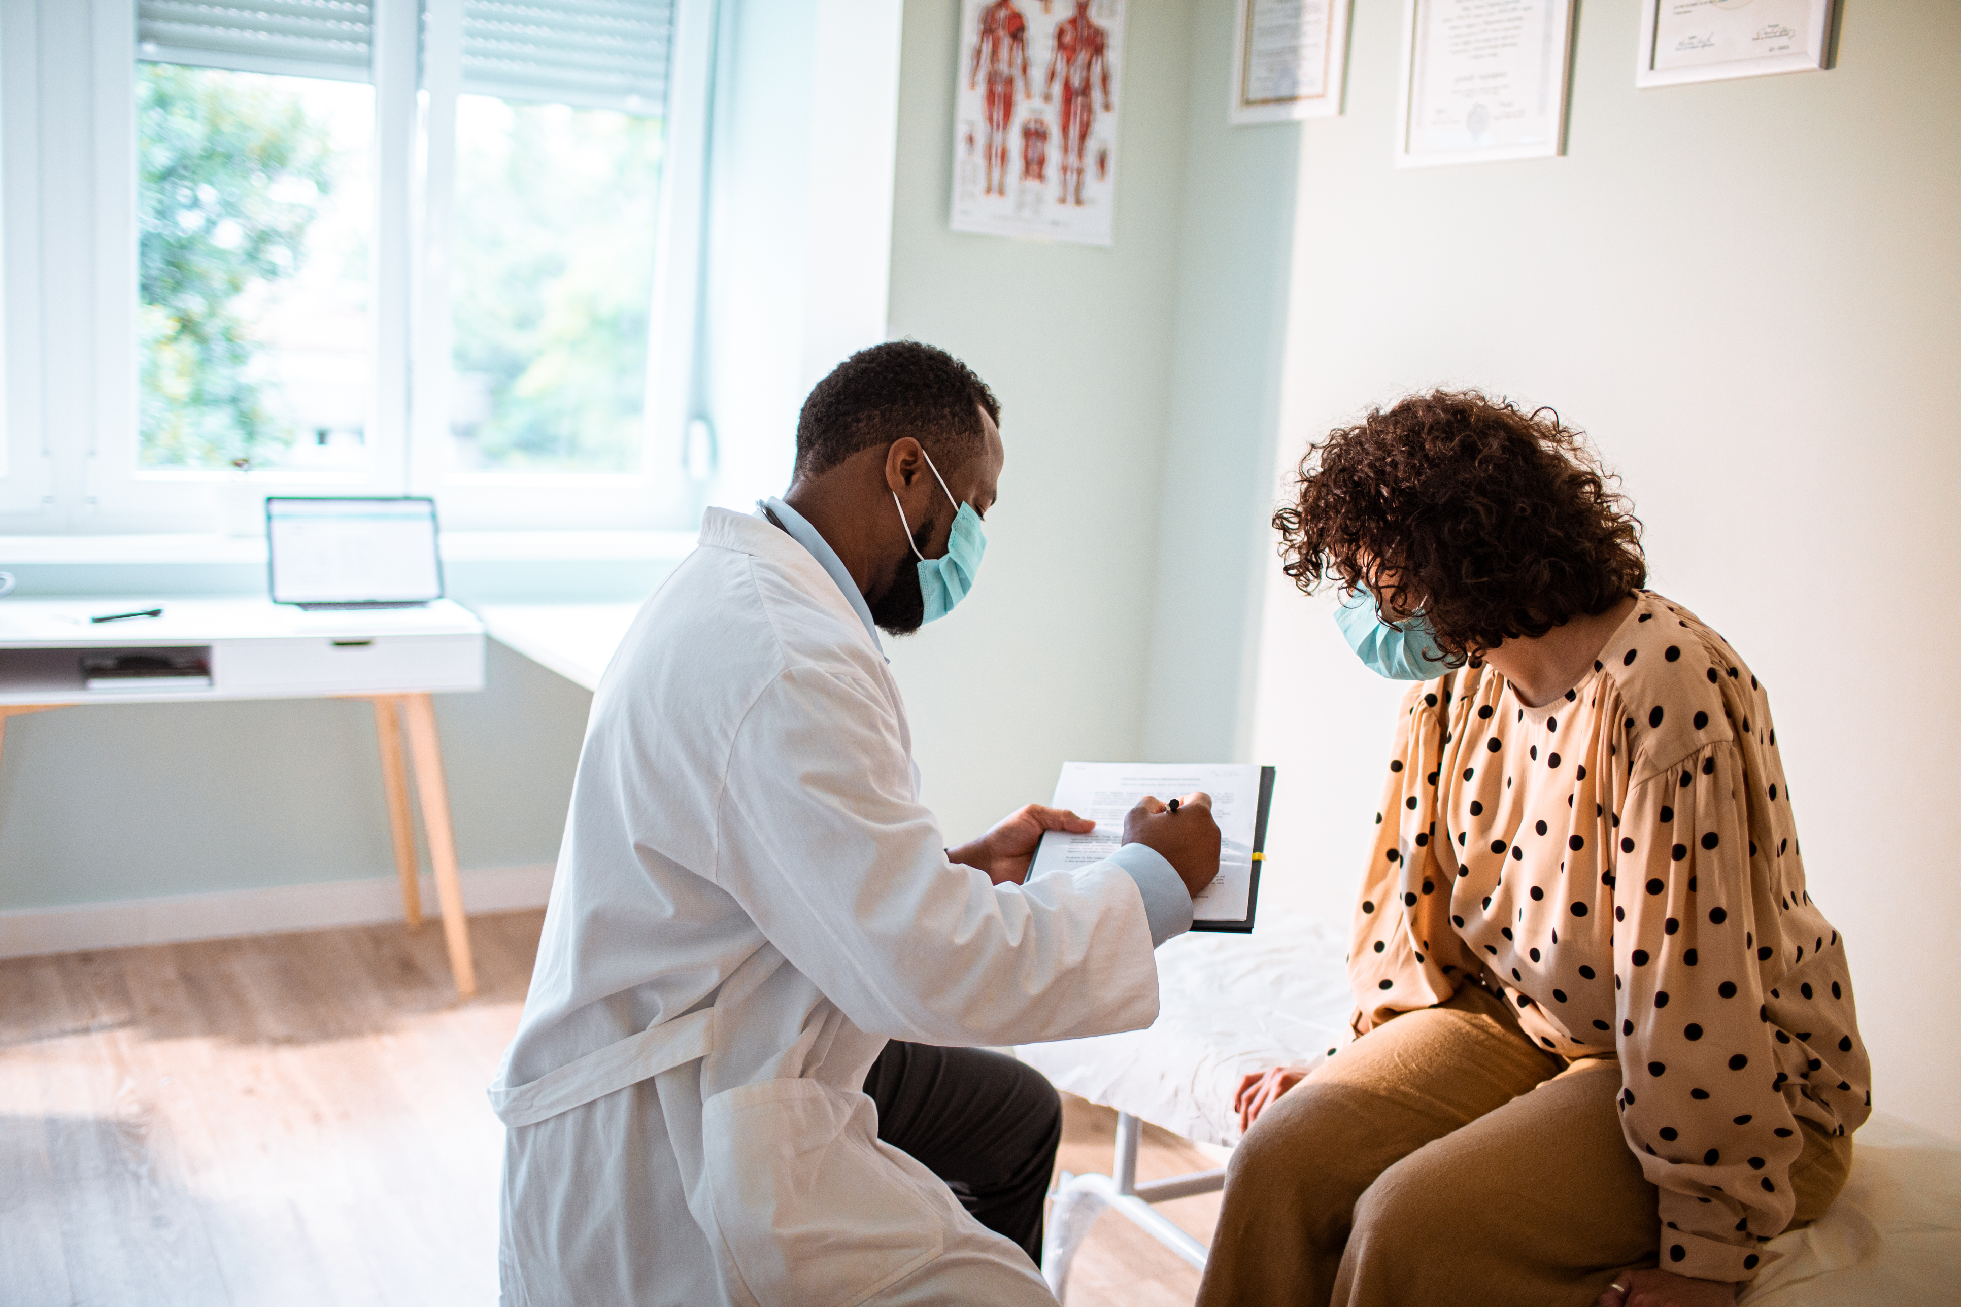
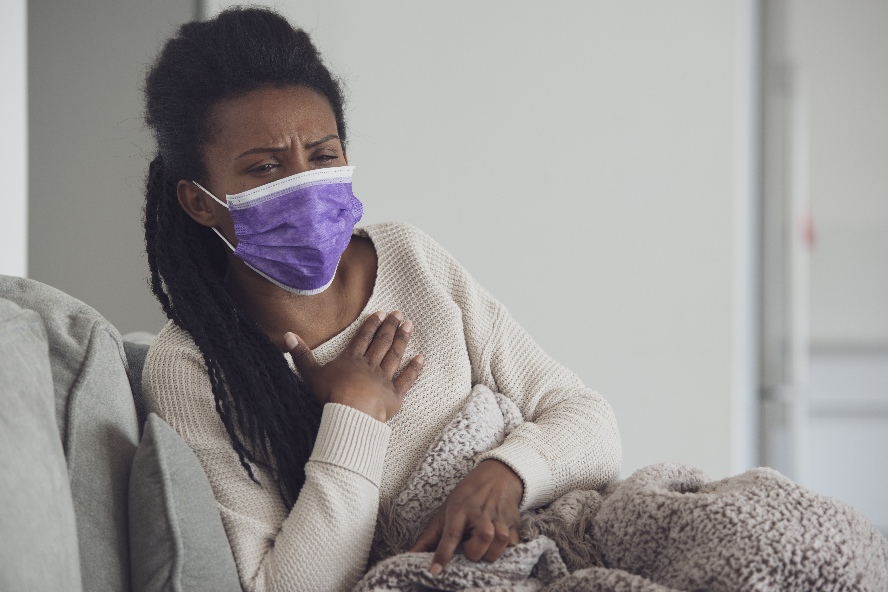
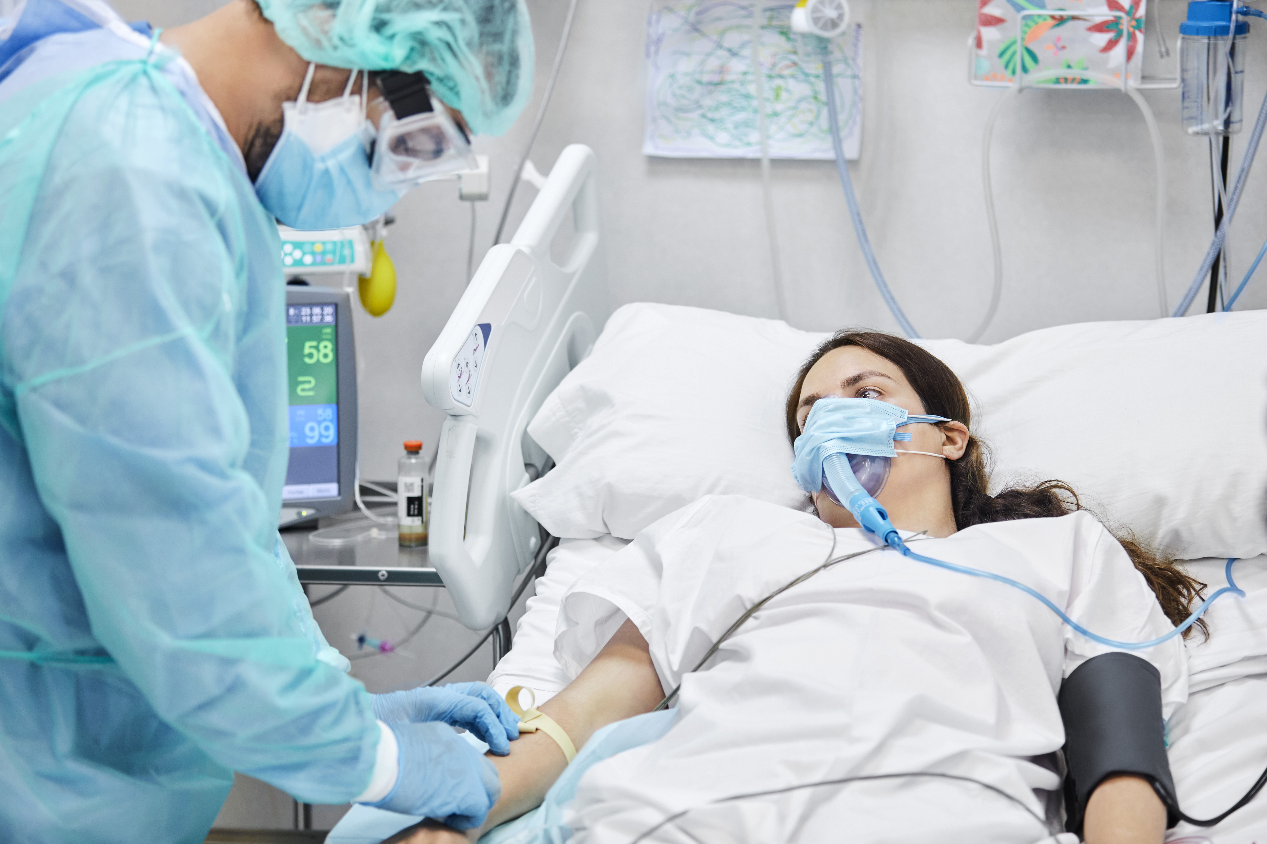
Koban māroñ jela an COVID-19 naaj jelōte kwe

Slide 6
Emāroñ laplok an kauwōtata ñan am bōke COVID-19 elañe…
Kwōj juōn armej in color
65 am iiō ak rittolok
Ewōr am nañinmej
Kwōj kōbaatat
65
Notes:
(pages 3-5 in booklet)

Slide 7
COVID-19 emāroñ jelōte mour eo am im ro jitenbūro ibbam
Elañe kwōbōke COVID-19, kwōmāroñ lelok ñan ro me emāroñ lap aer nañimej jene.
Emāroñ wōr am im ro jet broblem in kōmman jāān.
Emāroñ pen am bukõt ejmour ak taktõ.
Kwōmāroñ eñtaan ilo am kajjeoñ lale ro jet.

Slide 8
Bõk wā in COVID-19 ej wãwein eo emman tata ñan kejpārok kwe im ro jet

Slide 9
Ewi wãwein am jela ke wā in ej jerbal?

Slide 10
Ewi wãwein an wā in COVID-19 kar kōmman im lelok maroñ ñan kōjerbale
Emōj loore aolepen wãwein ko. Ejjelok wãwein ko kar jab loori.
Emōj donate billion tala ko.
Rikatak ro im ro jet rar jerbal iümwin awa ko.

Slide 11
Ebool kain armej rekar bōk konaer ilo clinical trial eo
Rikilmeej
Ri-Hispanic
Native American
im Ri-Asian
16 ñan 91 iiō

Slide 12
Ta ko ro jet rej ba kin wā in COVID-19

Slide 13
Kwōj aikuj bōke wā in COVID-19 eo
Elañe 12 am iiō ak rittolok
Jekdron ñe emōj am kar COVID-19
Elañe kwōj bõroro ak ewōr am nañinmej, kenono ibben taktō eo am im lale elañe wā in emman ñan kwe.

Slide 14
Ñaat eo ekkar ñan bōk wā in COVID-19
Ñaat
Emāroñ wōr 2nd dose
Kiō! Aolep ro 12 aer iiō im ruttolo̗k remaron̄ bōk wā in
Jet wā emāroñ 2 kōttan bōke
kakōlleiki raan eo kwoj wā kein karuo ie ilo calendar ne am

Slide 15
Jikin wā in COVID-19
Jikin ko
Onāān
Jikin Kaüno Ko
Ibben takto ro
Mõn taktõ eo ilo bukõn ne am
Ejjelo̗k onāān

Slide 16
Ta eo kwon kõtmāne elikin am bōke wā in COVID-19
Side effect ko
Metak koppan peim ilo ijo kwar wā ilo ie
Jidrik kōkalle in nañinmej in mejin
Kememej in likiti raan in dose eo am kein karüo ilo kõlanda eo am

Slide 17
Jet wāwein ko ñan bōbrae jen COVID-19 im broblem ko rej walok jene
 | Bōke wā in COVID-19 eo, jekdron ñe emōj am kar bōke COVID-19. |  | Jab bed ilo ien iaio ko im iloan moko eobrak kin armij
 | Ekkōnak am mask n̄e kwoj bed lo̗bwilej ak ibben ro me rejjab jokwe ibbam. |  | Kakutkut am kwal peim. Elañe komāroñ, kōjerbal dren mānāān im soap. Iri peim ibben dron iumwin 20 second.
 | Bed wōt mweimōm elañe kwōj nañinmej. |  | Be jijno nee jen ro jet ñe kwōj bed lobwilej.

Slide 18
Kajjitōk?
Emāroñ lōñ wōt am kajjitōk ikijien wā in COVID-19 in. Kwaikuj bōk aolep uwaak in kajjitōk ko am mokta jen am lemnak in bōke wā in.
Elañe ewōr am kajjitōk, kwōmāroñ:
Kenono ibben taktō eo am
Kenono ibben Ri-kaüno eo am
Kūrlok Arkansas Department of Health
Call: 1-800-803-7847
Email: ADH.CoronaVirus@arkansas.gov

